Slide 1
B-splines
Tutorial 1 - Introduction

Slide 2
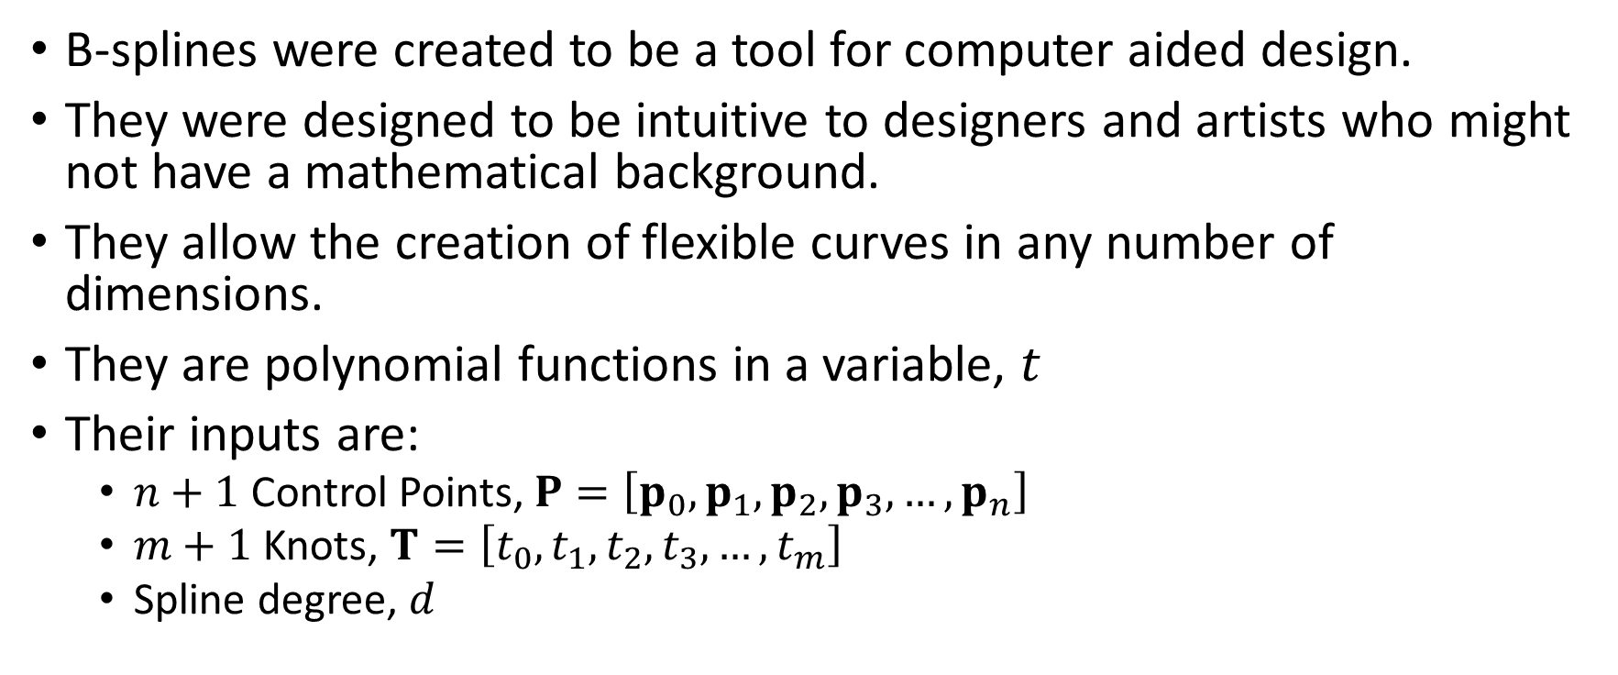
B-splines
B-splines were created to be a tool for computer aided design.
They were designed to be intuitive to designers and artists who might not have a mathematical background.
They allow the creation of flexible curves in any number of dimensions.
They are polynomial functions in a variable, $t$
Their inputs are:
  $n+1$ Control Points, $P=\left[p_{0},p_{1},p_{2},p_{3},…,p_{n}\right]$
  $m+1$ Knots, $T=\left[t_{0},t_{1},t_{2},t_{3},…,t_{m}\right]$
  Spline degree, $d$

Slide 3
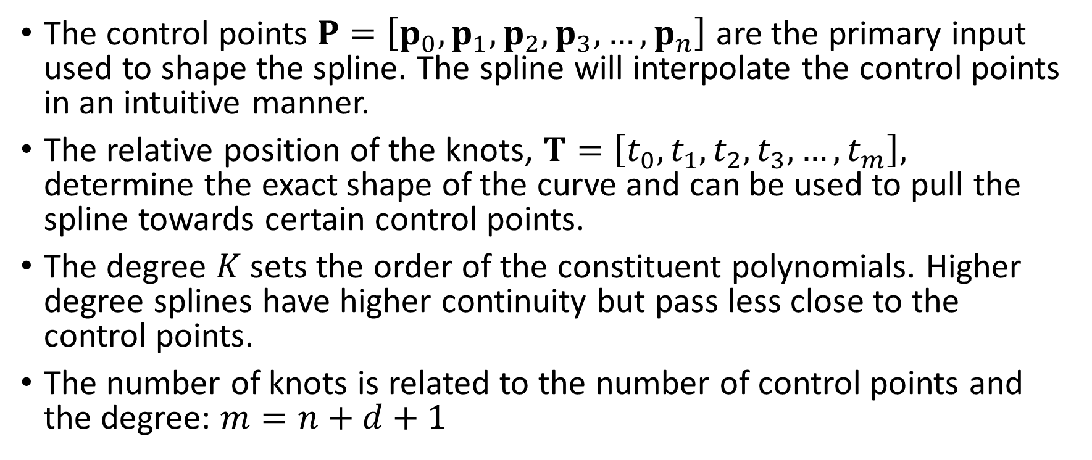
B-Spline inputs
The control points $P=\left[p_{0},p_{1},p_{2},p_{3},…,p_{n}\right]$ are the primary input used to shape the spline. The spline will interpolate the control points in an intuitive manner.
The relative position of the knots, $T=\left[t_{0},t_{1},t_{2},t_{3},…,t_{m}\right],$ determine the exact shape of the curve and can be used to pull the spline towards certain control points.
The degree $K$ sets the order of the constituent polynomials. Higher degree splines have higher continuity but pass less close to the control points.
The number of knots is related to the number of control points and the degree: $m=n+d+1$

Slide 4
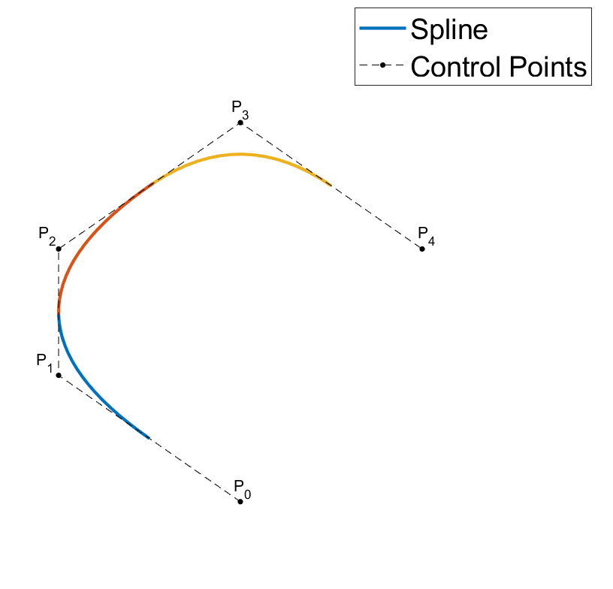






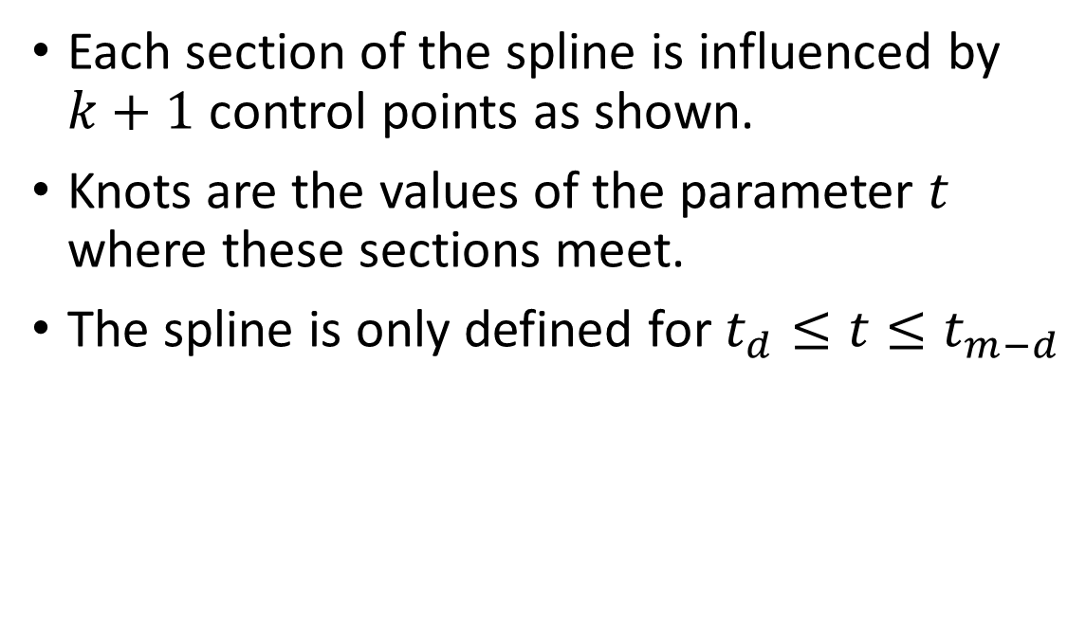

B-splines
$$t_{4}$$
$$t_{5}$$
Each section of the spline is influenced by $k+1$ control points as shown.
Knots are the values of the parameter $t$ where these sections meet.
The spline is only defined for $t_{d}≤t≤t_{m−d}$
$$P_{2}−P_{4}$$
$$P_{1}−P_{3}$$
$$t_{3}$$
$$P_{0}−P_{2}$$
$$t_{2}$$

Slide 5


B-spline definition
The spline curve $S(t)$ is defined as shown:
$$S\left(t\right)=\sum_{i=0}^{n}{N_{i,d}\left(t\right)p_{i}}$$
The basis functions $N_{i,D}\left(t\right)$ are defined by the Cox de Boor recursion formula:
$$N_{i,0}\left(t\right)= \left\{\begin{aligned}1, \text{if} t∈[t_{i},t_{i+1}) \\ 0, \text{otherwise} \end{aligned}\right.$$
$$N_{i,j}\left(t\right)=\frac{t−t_{i}}{t_{i+j}−t_{i}}N_{i,j−1}\left(t\right)+\frac{t_{i+j+1}−t}{t_{i+j+1}−t_{i+1}}N_{i+1,j−1}\left(t\right)$$
Spline
Control Points
Basis Functions
Notes:
Consider changing the degree k and the mobile k in the recursion formula
Consider changing t_i to something that isn’t t

Slide 6







Basis Functions
$$N_{i,0}\left(t\right)= \left\{\begin{aligned}1, \text{if} t∈[t_{i},t_{i+1}) \\ 0, \text{otherwise} \end{aligned}\right.$$
$$N_{i,j}\left(t\right)=\frac{t−t_{i}}{t_{i+j}−t_{i}}N_{i,j−1}\left(t\right)+\frac{t_{i+j+1}−t}{t_{i+j+1}−t_{i+1}}N_{i+1,d−1}\left(t\right)$$
$$N_{0,0}$$
$$N_{0,1}$$
$$N_{1,0}$$
$$N_{0,2}$$
$$N_{1,1}$$
$$N_{2,0}$$

Slide 7
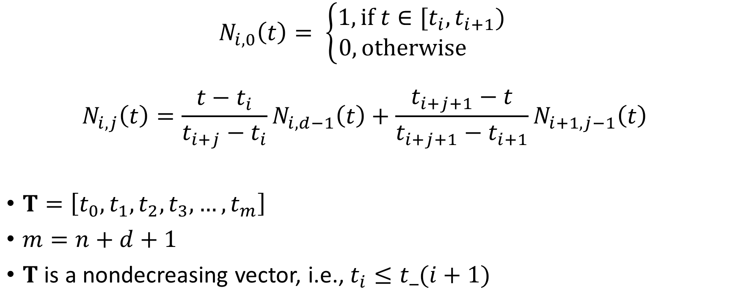
The knot vector
$$N_{i,0}\left(t\right)= \left\{\begin{aligned}1, \text{if} t∈[t_{i},t_{i+1}) \\ 0, \text{otherwise} \end{aligned}\right.$$
$$N_{i,j}\left(t\right)=\frac{t−t_{i}}{t_{i+j}−t_{i}}N_{i,d−1}\left(t\right)+\frac{t_{i+j+1}−t}{t_{i+j+1}−t_{i+1}}N_{i+1,j−1}\left(t\right)$$
$T=\left[t_{0},t_{1},t_{2},t_{3},…,t_{m}\right]$
$m=n+d+1$
$T$ is a nondecreasing vector, i.e., $t_{i}≤t_(i+1)$
Notes:
The values of ti in the basis functions are taken from a sequence called the knot vector.
At any given point on the spline, knots that t lies between determine which basis functions affect the shape of the curve.
The size of T is related to the spline degree and the number of control points by m = n + k + 1
T must also be non-decreasing – time cannot move backwards :P

Slide 8

A uniform quadratic spline
$P= [p_{0},p_{1},p_{2}]$
$n=2$
$d=2$
$m=n+d+1=5$
Equidistant knots = uniform spline
$T=\left[t_{0},t_{1},t_{2},t_{3},t_{4},t_{5}\right]=\left[0,1,2,3,4,5\right]$
$$S\left(t\right)=\sum_{i=0}^{2}{N_{i,2}\left(t\right)p_{i}}$$

Slide 9

Basis Functions
$$N_{i,0}\left(t\right)= \left\{\begin{aligned}1, \text{if} t∈[t_{i},t_{i+1}) \\ 0, \text{otherwise} \end{aligned}\right.$$
$$N_{i,j}\left(t\right)=\frac{t−t_{i}}{t_{i+j}−t_{i}}N_{i,j−1}\left(t\right)+\frac{t_{i+j+1}−t}{t_{i+j+1}−t_{i+1}}N_{i+1,j−1}\left(t\right)$$
$$N_{0,0}$$
$$N_{0,1}$$
$$N_{1,0}$$
$$N_{0,2}$$
$$N_{1,1}$$
$$N_{2,0}$$

Slide 10

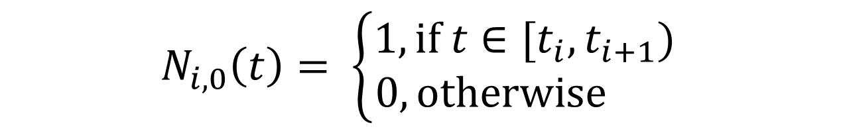


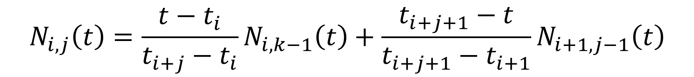


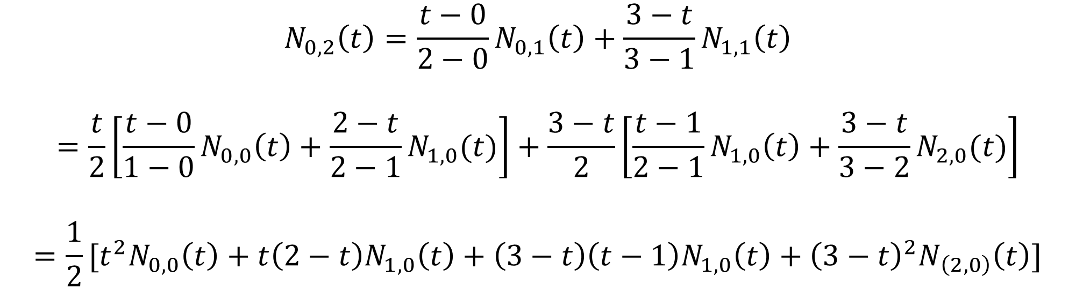

A uniform quadratic B-spline
$$N_{0,0}$$
$$N_{0,1}$$
$$N_{1,0}$$
$$N_{0,2}$$
$$N_{1,1}$$
$$N_{2,0}$$
$$N_{i,0}\left(t\right)= \left\{\begin{aligned}1, \text{if} t∈[t_{i},t_{i+1}) \\ 0, \text{otherwise} \end{aligned}\right.$$
$$N_{i,j}\left(t\right)=\frac{t−t_{i}}{t_{i+j}−t_{i}}N_{i,k−1}\left(t\right)+\frac{t_{i+j+1}−t}{t_{i+j+1}−t_{i+1}}N_{i+1,j−1}\left(t\right)$$
$$N_{0,2}\left(t\right)=\frac{t−0}{2−0}N_{0,1}\left(t\right)+\frac{3−t}{3−1}N_{1,1}\left(t\right)$$
$$=\frac{t}{2}\left[\frac{t−0}{1−0}N_{0,0}\left(t\right)+\frac{2−t}{2−1}N_{1,0}(t)\right]+\frac{3−t}{2}\left[\frac{t−1}{2−1}N_{1,0}\left(t\right)+\frac{3−t}{3−2}N_{2,0}(t)\right]$$
$$=\frac{1}{2}[t^{2}N_{0,0}\left(t\right)+t\left(2−t\right)N_{1,0}\left(t\right)+\left(3−t\right)\left(t−1\right)N_{1,0}\left(t\right)+{\left(3−t\right)}^{2}N_{\left(2,0\right)}\left(t\right)]$$

Slide 11
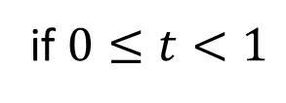
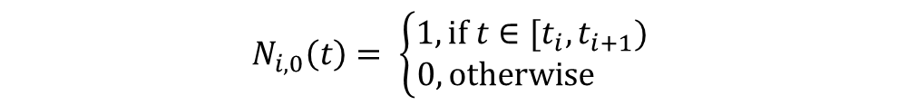
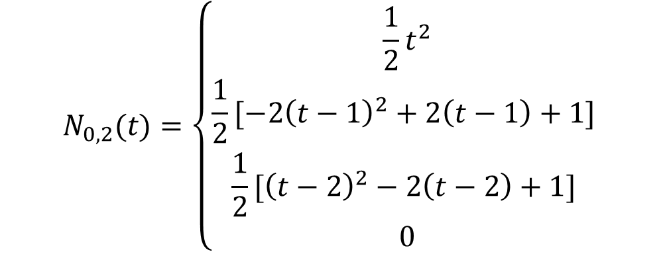

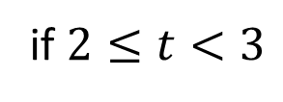

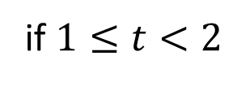

A uniform quadratic B-spline
$$N_{i,0}\left(t\right)= \left\{\begin{aligned}1, \text{if} t∈[t_{i},t_{i+1}) \\ 0, \text{otherwise} \end{aligned}\right.$$
$$T=\left[t_{0},t_{1},t_{2},t_{3},t_{4},t_{5}\right]=\left[0,1,2,3,4,5\right]$$
$$N_{0,2}(t)=\frac{1}{2}[t^{2}N_{0,0}\left(t\right)+t\left(2−t\right)N_{1,0}\left(t\right)+\left(3−t\right)\left(t−1\right)N_{1,0}\left(t\right)+{\left(3−t\right)}^{2}N_{\left(2,0\right)}\left(t\right)]$$
$$2≤t<3$$
$$0≤t<1$$
$$1≤t<2$$
$$N_{0,2}(t)=\left\{\begin{aligned}\frac{1}{2}t^{2} \\ \frac{1}{2}[−2{\left(t−1\right)}^{2}+2\left(t−1\right)+1] \\ \frac{1}{2}[{\left(t−2\right)}^{2}−2\left(t−2\right)+1] \\ 0\end{aligned}\right.$$
if $0≤t<1$
if $1≤t<2$
if $2≤t<3$
otherwise

Slide 12
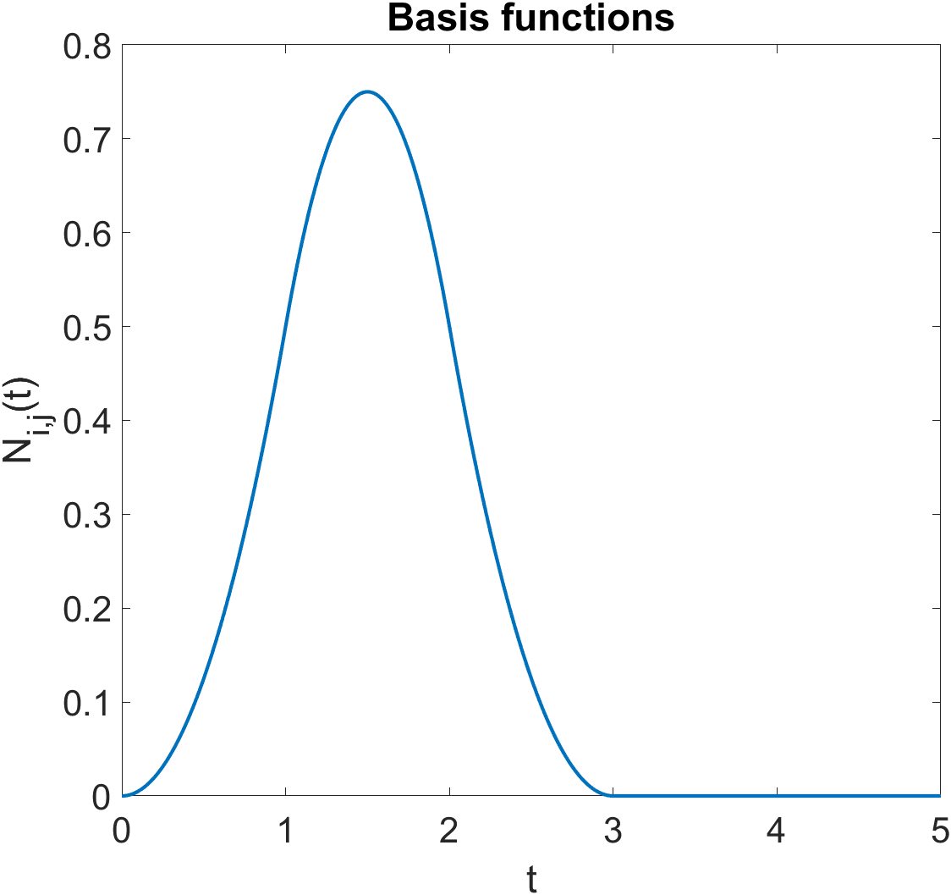
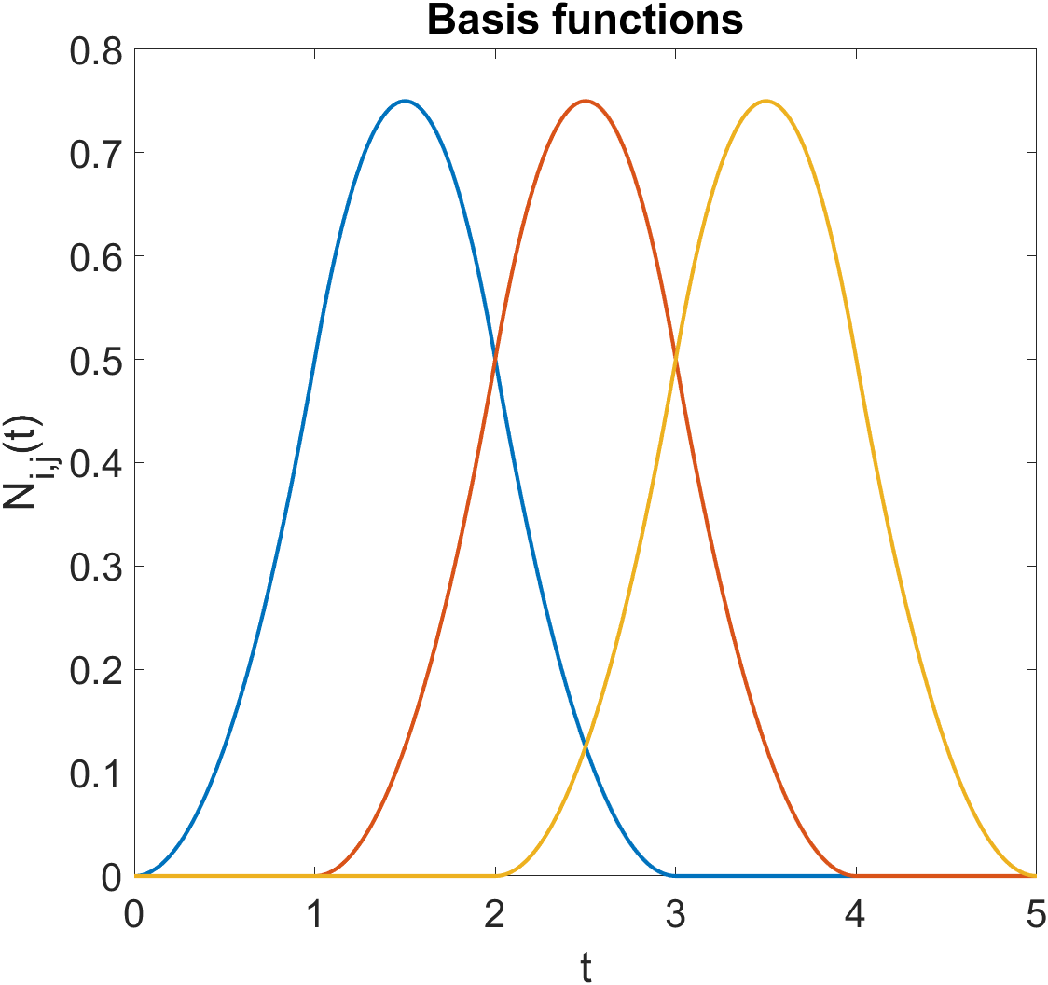




$$N_{0,2}(t)$$
$$N_{1,2}(t)$$
$$N_{2,2}(t)$$
The spline is only defined where $d+1$basis functions are non-zero
This corresponds to $t_{d}≤t≤t_{m−d}$

Slide 13
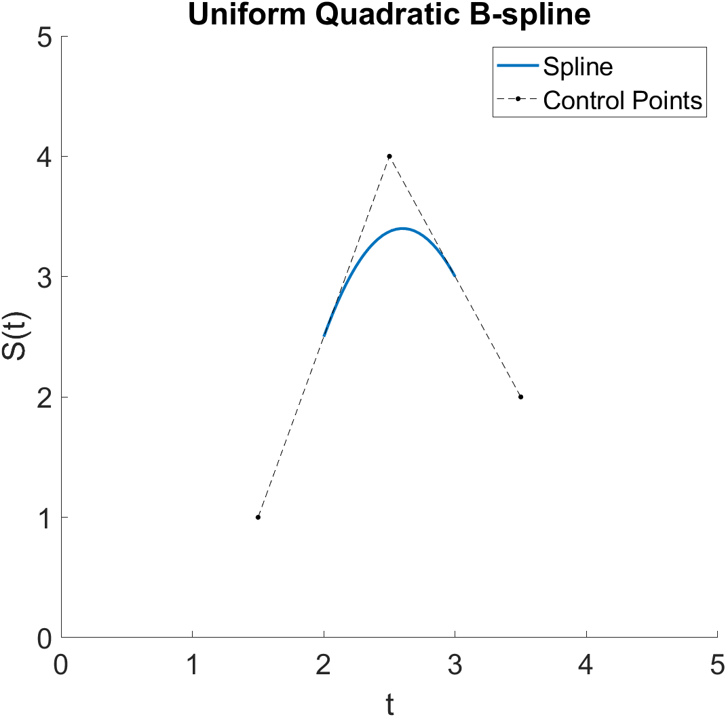

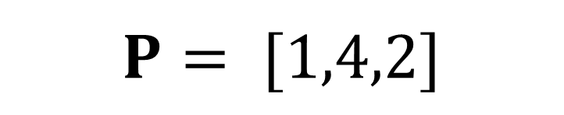


$$P= [1,4,2]$$
$$N_{0,2}(t)$$
$$N_{1,2}(t)$$
$$N_{2,2}(t)$$

Slide 14

Effect of control points

Slide 15
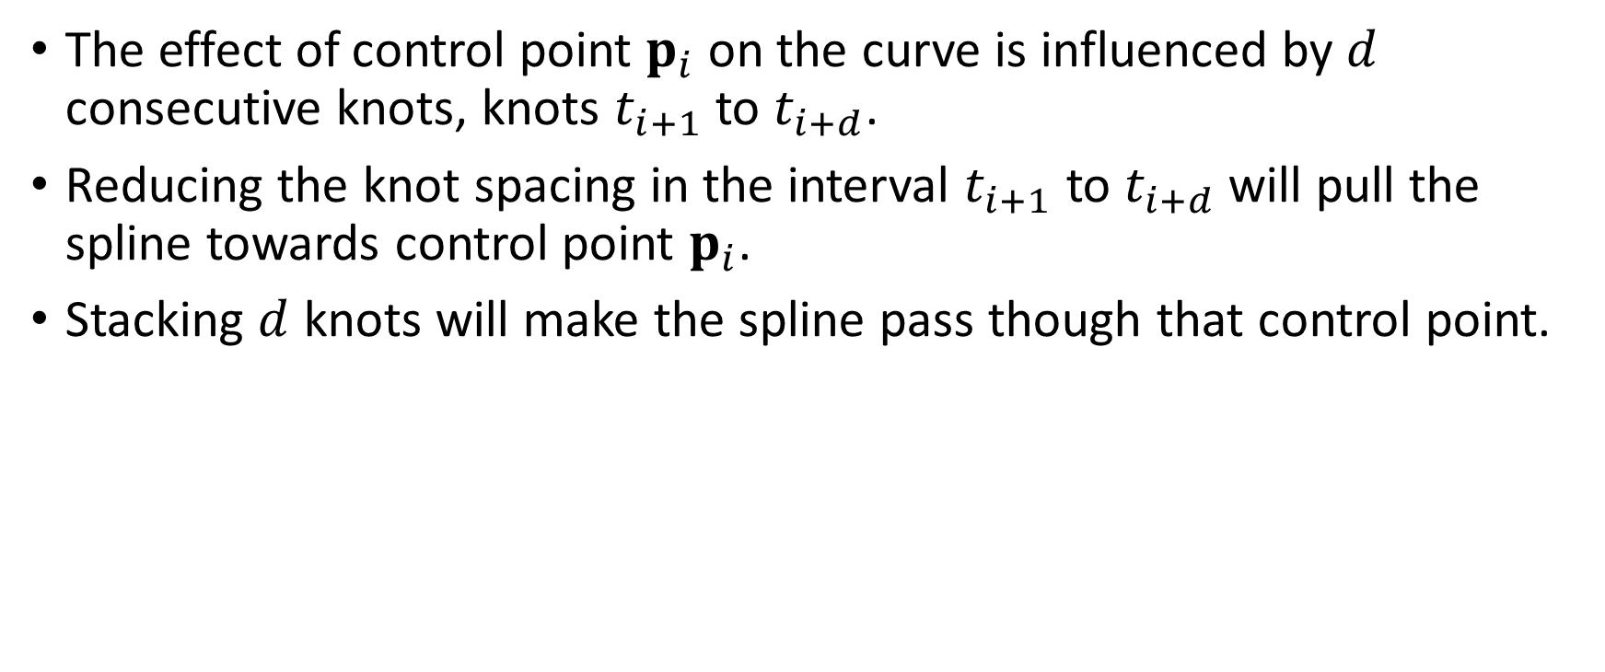
Effect of knot adjustment
The effect of control point $p_{i}$ on the curve is influenced by $d$ consecutive knots, knots $t_{i+1}$ to $t_{i+d}$.
Reducing the knot spacing in the interval $t_{i+1}$ to $t_{i+d}$ will pull the spline towards control point $p_{i}$.
Stacking $d$ knots will make the spline pass though that control point.

Slide 16
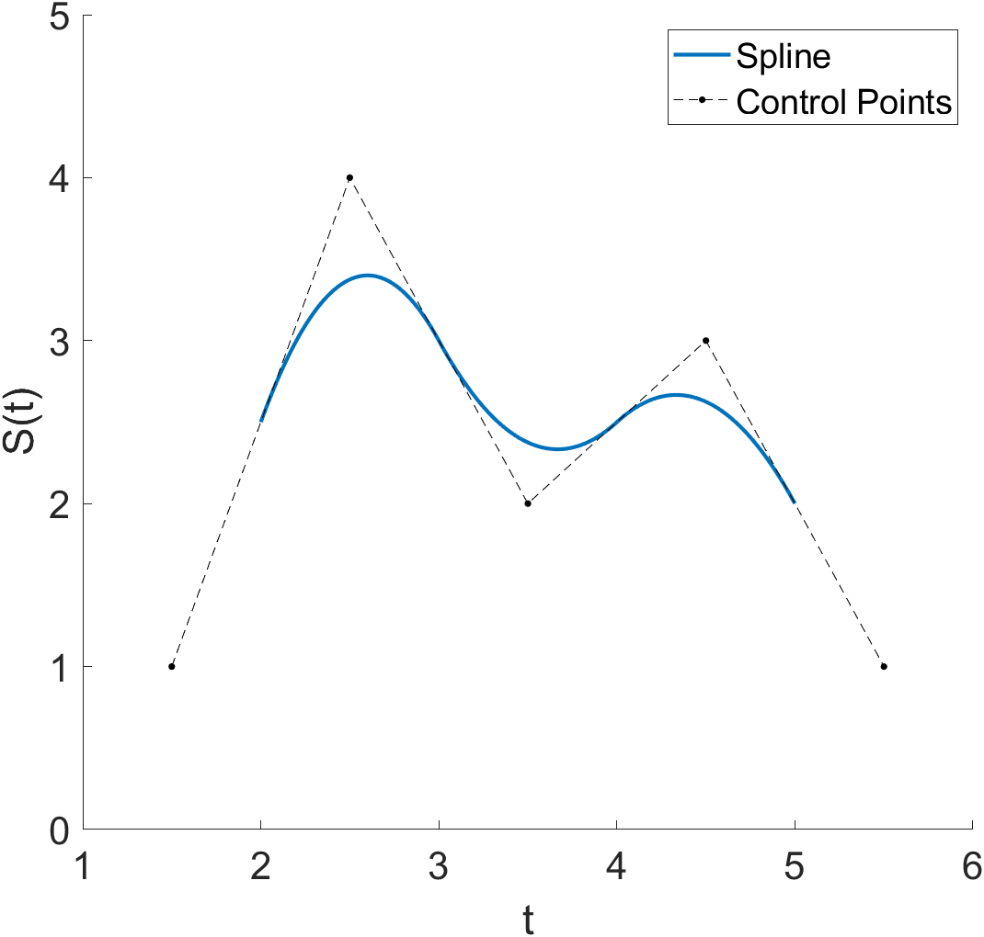
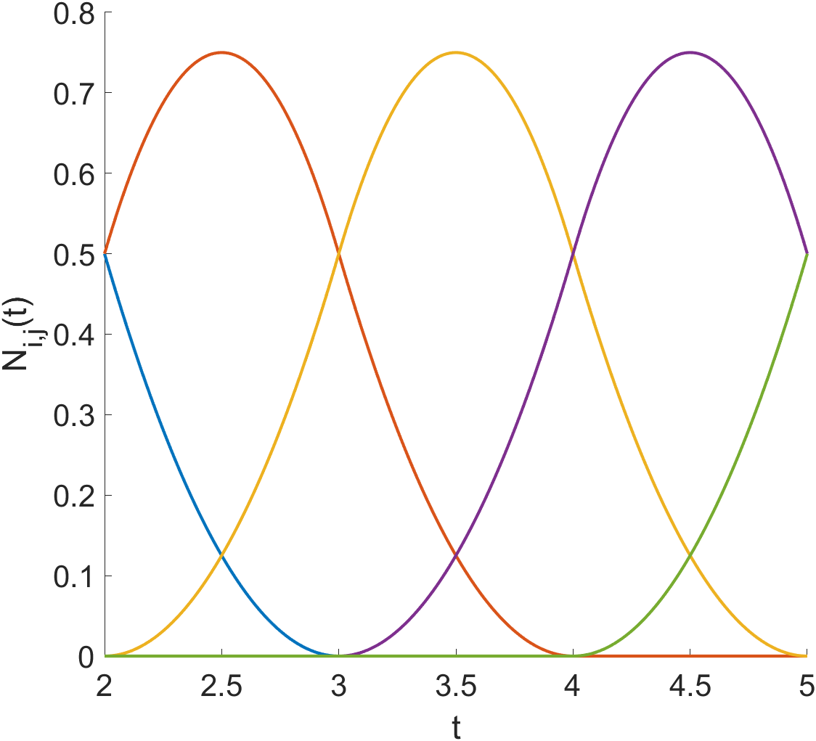
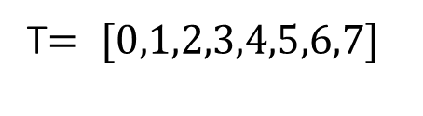
Effect of knot adjustment
T$= [0,1,2,3,4,5,6,7]$

Slide 17
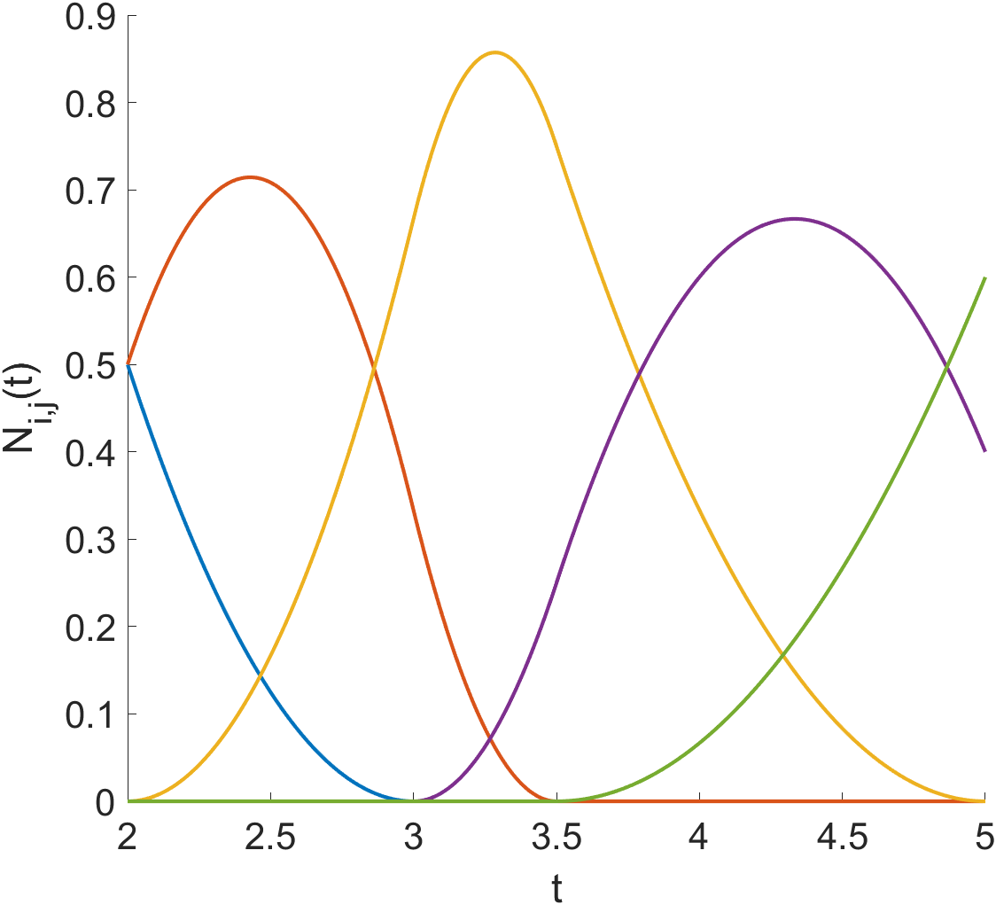
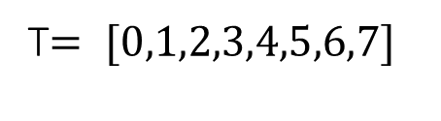
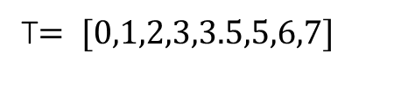
Effect of knot adjustment
T$= [0,1,2,3,4,5,6,7]$
T$= [0,1,2,3,3.5,5,6,7]$

Slide 18
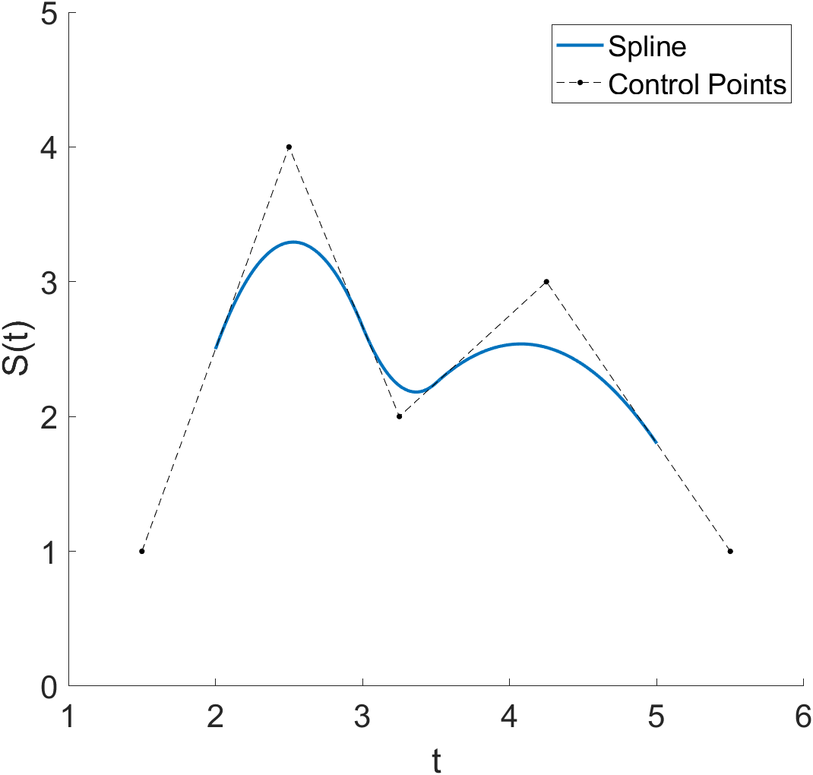
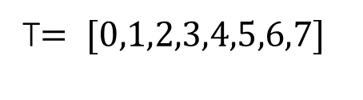
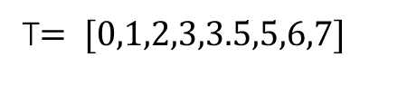
Effect of knot adjustment
T$= [0,1,2,3,4,5,6,7]$
T$= [0,1,2,3,3.5,5,6,7]$

Slide 19
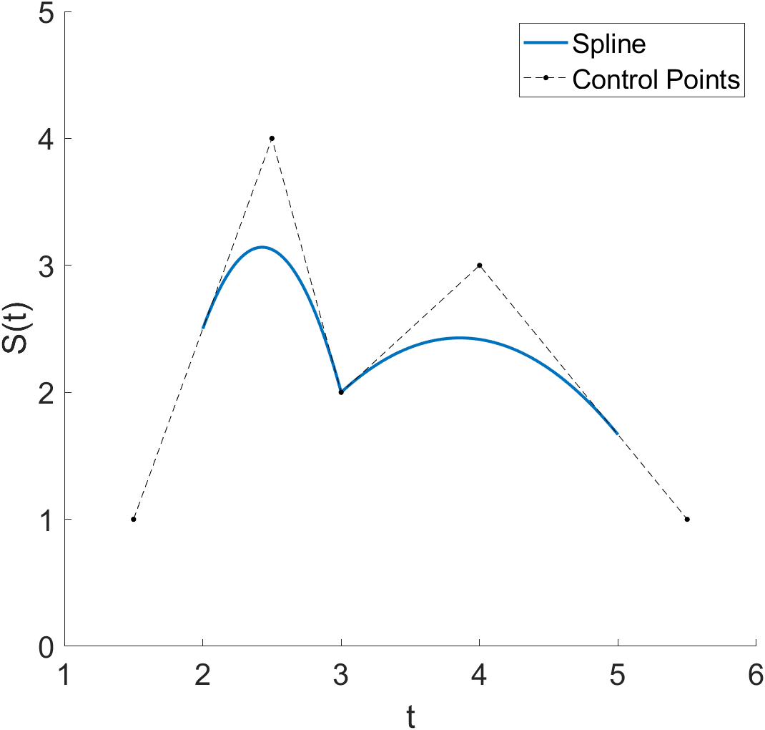
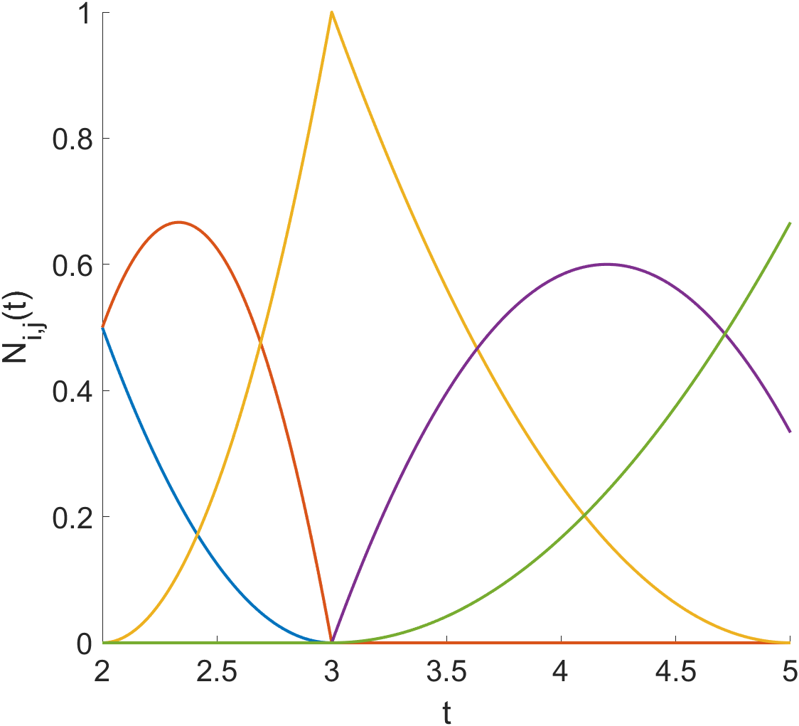
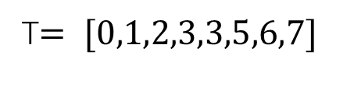
Effect of knot adjustment
T$= [0,1,2,3,3,5,6,7]$

Slide 20
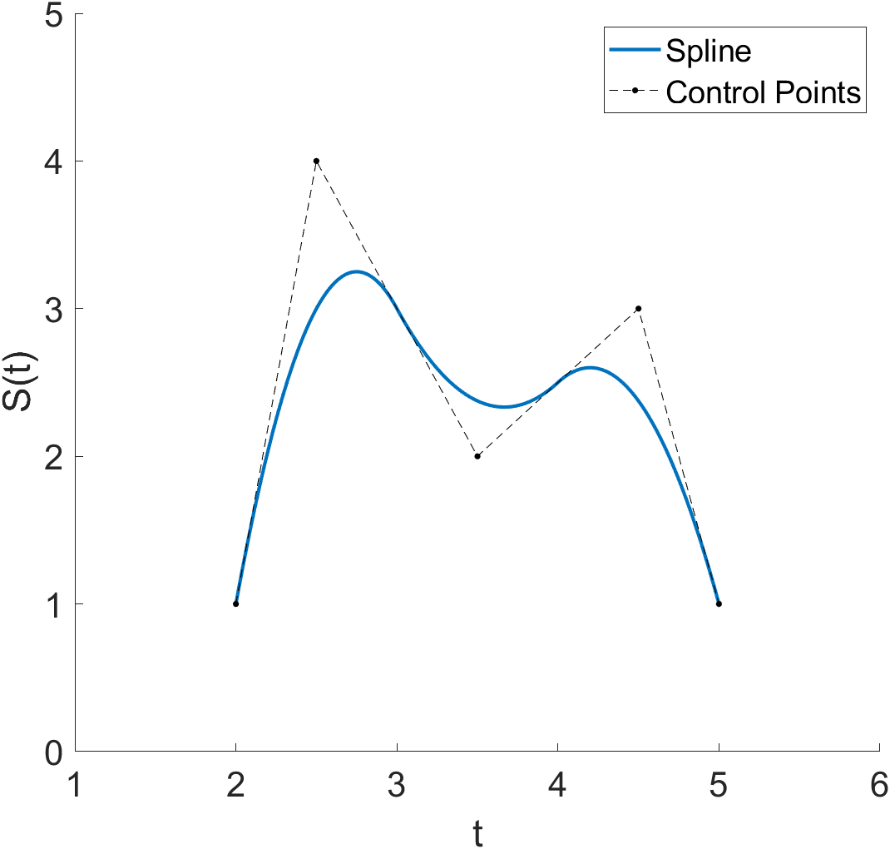
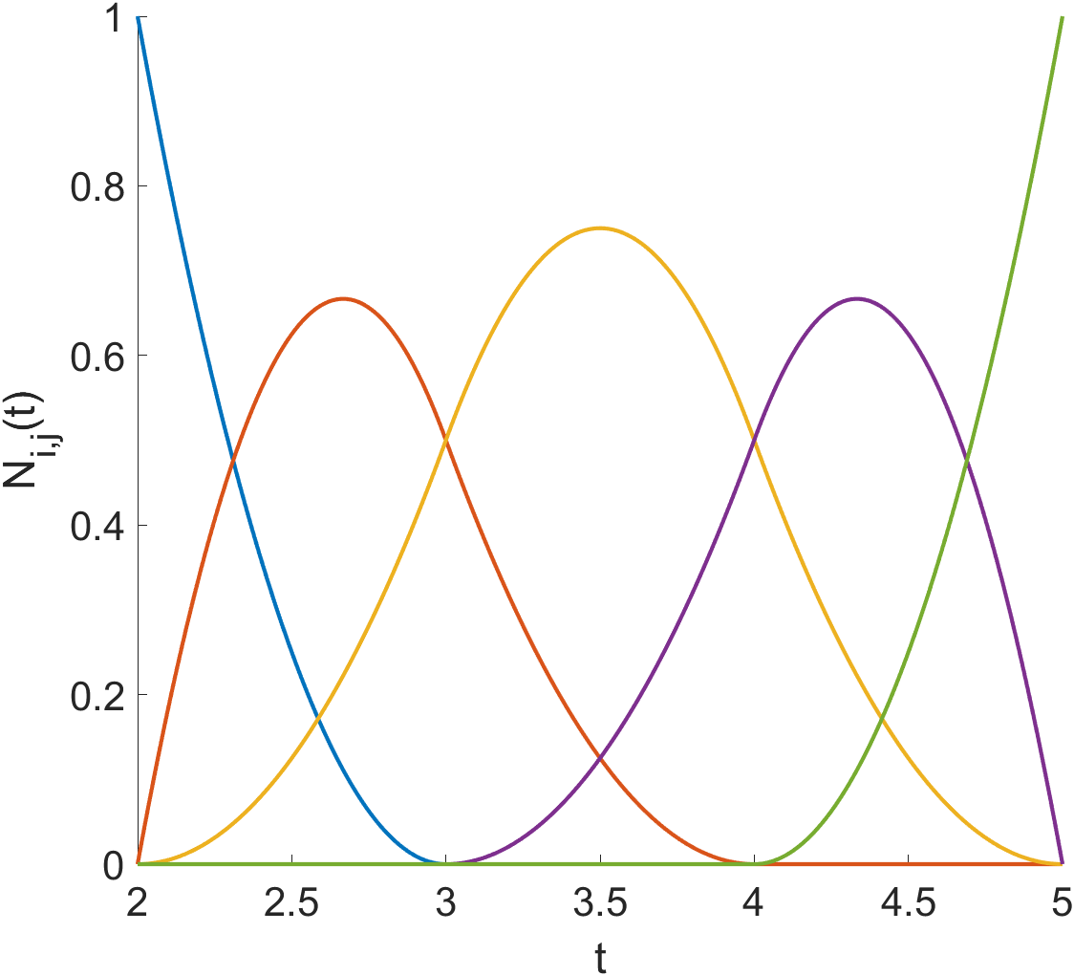
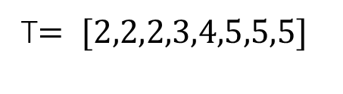
Effect of knot adjustment
T$= [2,2,2,3,4,5,5,5]$

Slide 21
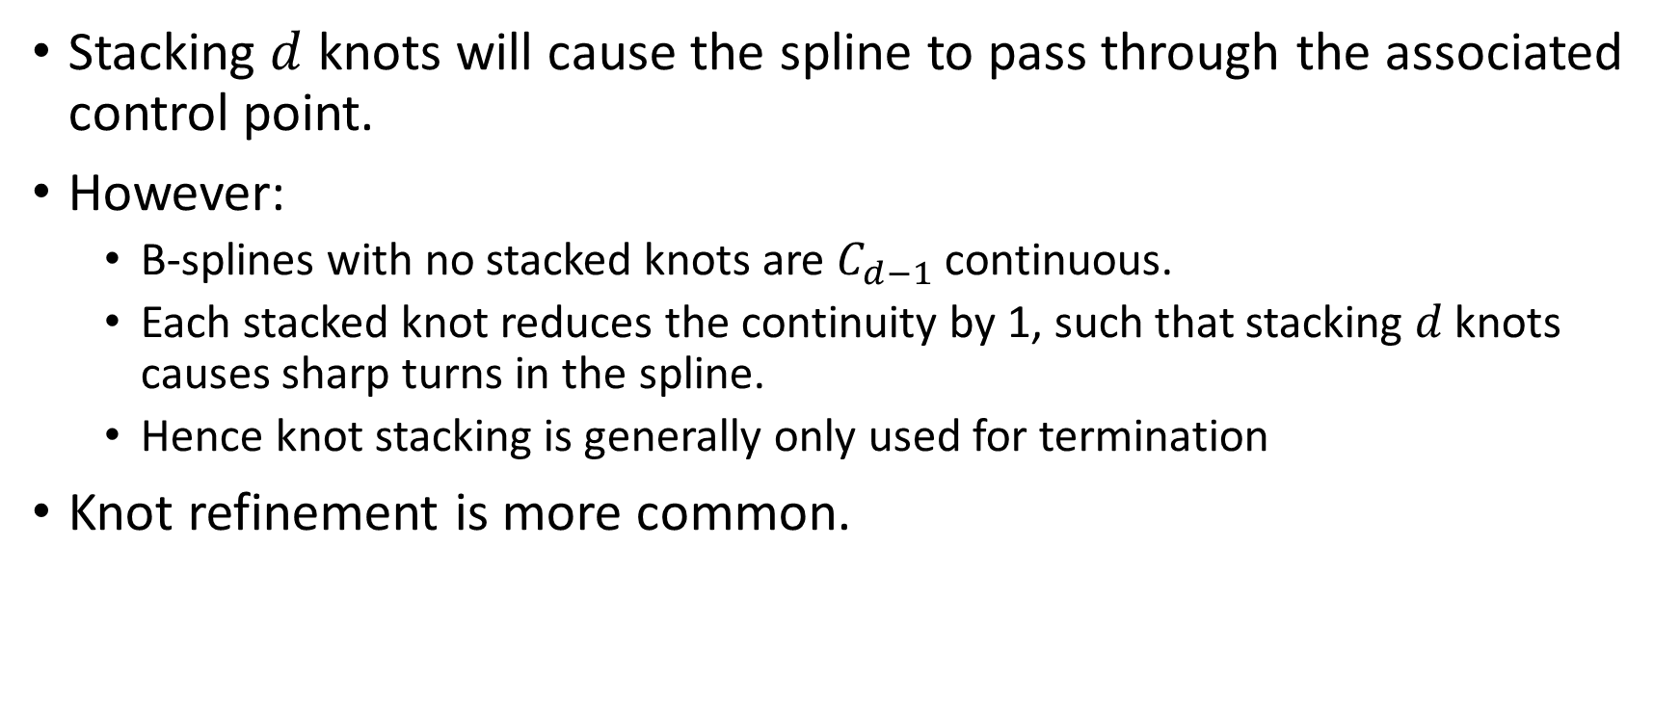
Knot adjustment
Stacking $d$ knots will cause the spline to pass through the associated control point.
However:
  B-splines with no stacked knots are $C_{d−1}$ continuous.
  Each stacked knot reduces the continuity by 1, such that stacking $d$ knots causes sharp turns in the spline.
  Hence knot stacking is generally only used for termination
Knot refinement is more common.
Notes:
As we saw previously, stacking $k$ knots will cause the spline to pass through the associated control point.
However:
B-splines with no stacked knots are $C_{k−1}$ continuous across their knots. They are always entirely continuous between knots.
Each stacked knot reduces the continuity by 1, such that stacking $k$ knots causes sharp turns in the spline.
Stacking $k+1$ knots will make the spline discontinuous, essentially producing 2 separate splines.
Hence knot stacking is generally only used for termination, i.e. making the spline pass through its start and end points
Knot refinement is common. This is most often where each knot interval is bisected by another knot, and each control point span is bisected by another control point, which brings the spline closer to the control polyline, but simply could be adjusting the knots small amounts to get the desired shape

Slide 22
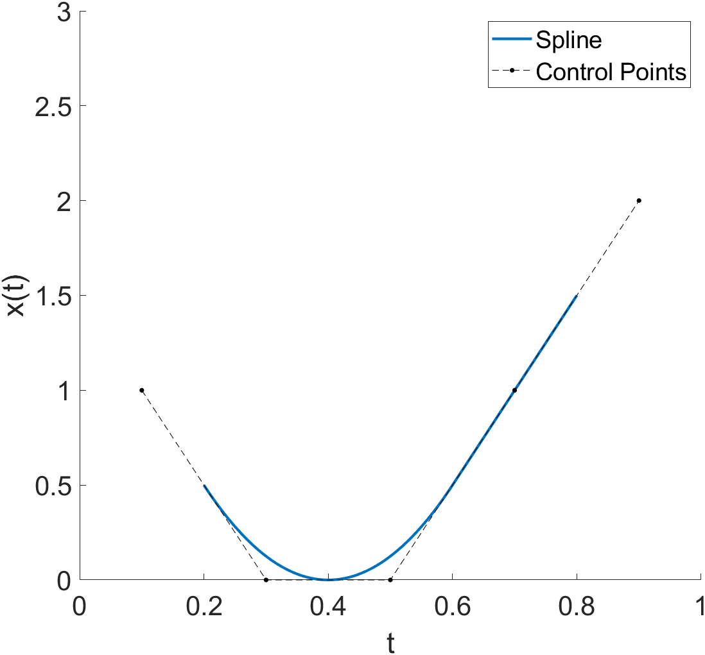
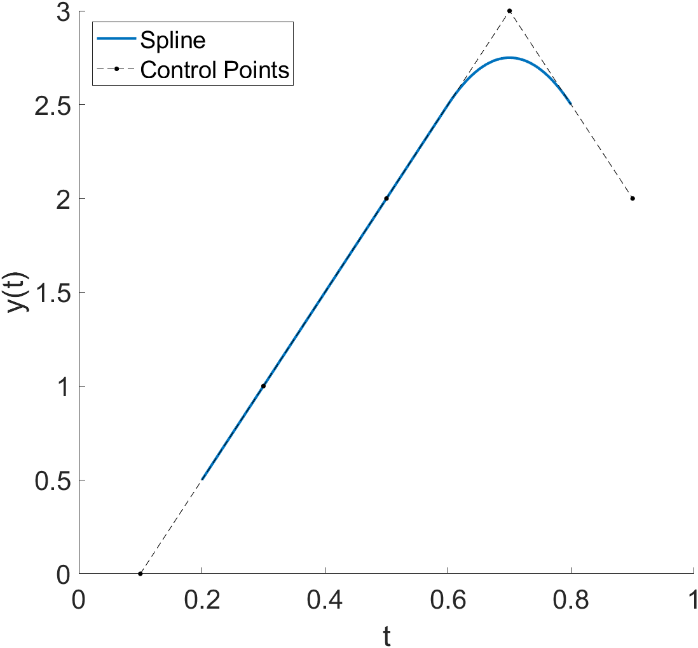

More than 1 Dimension
$S\left(t\right)=[x\left(t\right),y\left(t\right)]$
Notes:
Splines in multiple dimensions are just separate splines over the same knots vector

Slide 23
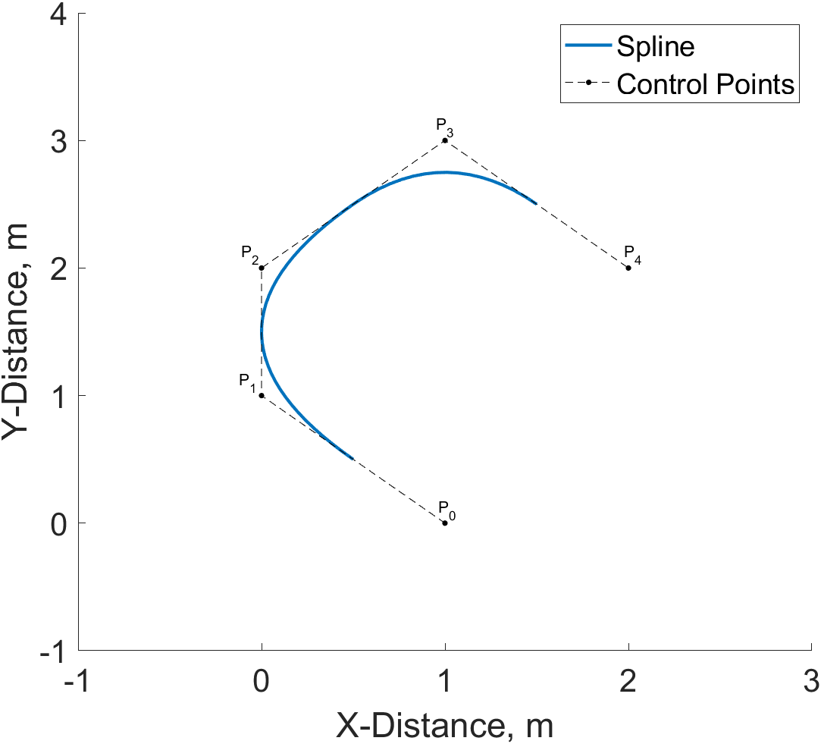
More than 1-D
$S\left(t\right)=[x\left(t\right),y\left(t\right)]$
Notes:
Splines in multiple dimensions are just separate splines over the same knots vector

